Slide 1
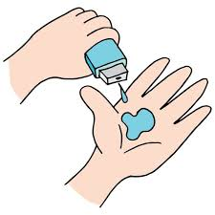
Team Achievers
Final Project

Slide 2
PROJECT TITLE
Real-Time Sign Language Recognition Using Convolutional Neural Network

Slide 3

AGENDA
Aim of our project is to develop a concept of a virtual talking system without sensors for people in need, this concept is achieved by using image processing and human hand gesture input. This mainly helps people who can’t talk with other people.

Slide 4

PROBLEM STATEMENT
Dumb people use hand signs to communicate, hence normal people face problem in recognizing their language by signs made.
Hence there is a need of the systems which recognizes the different signs and conveys the information to the normal people.

Slide 5

PROJECT OVERVIEW
The main objectives of this project are to contribute to the field of automatic sign language recognition and translation to text or speech.
In our project, we focus on static sign language hand gestures. This work focused on recognizing the hand gestures which includes 26 English alphabets (A-Z) and 10 digits (0-9) using CNN .
We created a convolution neural networks classifier that can classify the hand gestures into English alphabets and digits.

Slide 6

WHO ARE THE END USERS?
The challenge faced by dumb and deaf people while communicating with the system in work place , since they cannot hear it, dangerous to go places alone because they cannot hear car, bikes, or other people coming.
They cannot adapt to the surrounding environment quickly and respond to other normal people and expressing themselves is hard.

Slide 7
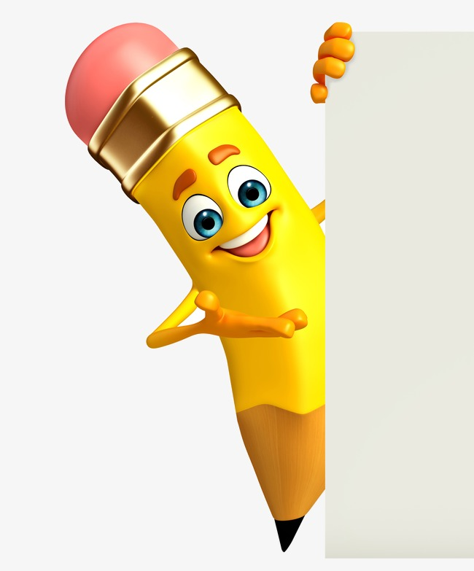
YOUR SOLUTION AND ITS VALUE PROPOSITION
The approach followed can be simply divided into two segments one is image processing and machine learning.
From image processing images are pre-processed and the dataset is formed then this dataset is used to train and test the CNN model formed in the machine learning segment.

Slide 8

THE WOW IN YOUR SOLUTION
➢ When comparing with existing system user can give more signs
➢ The module provides two way communication which helps in easy interaction between the normal people and disables
➢ Easy to Interface
➢ Flexible

Slide 9
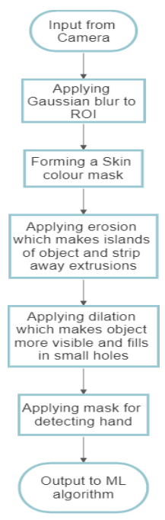
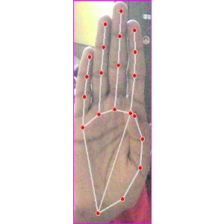
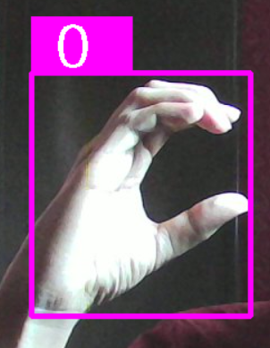
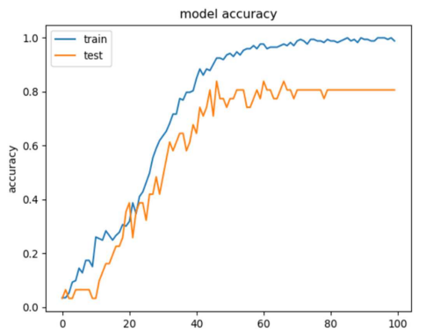
MODELLING

Slide 10
RESULTS
The results are purposefully taken in different background and lighting conditions to test the robustness of the algorithm and how it reacts when the environment changes.
They are taken in different illuminations and backgrounds. Still, it is able to detect all the signs and gives an output accuracy of 83%.
Repository Link :
https://github.com/Aditya1959/IBMSkillbuild-Project

Slide 11
MEET OUR TEAM
Aditya Prajapati
B.E Computer Engineering
Thakur College Of Engineering & Technology
Mumbai,India
Mentors:
Utkarsh Sharma
B.M Patel
Edunet Foundation
.
.

